Slide 1
Stakeholders Working Committee Meeting
July 11, 2019
TIJUANA
Secretaría de Seguridad Pública
SMARTBORDERCOALITION.COM

Slide 2
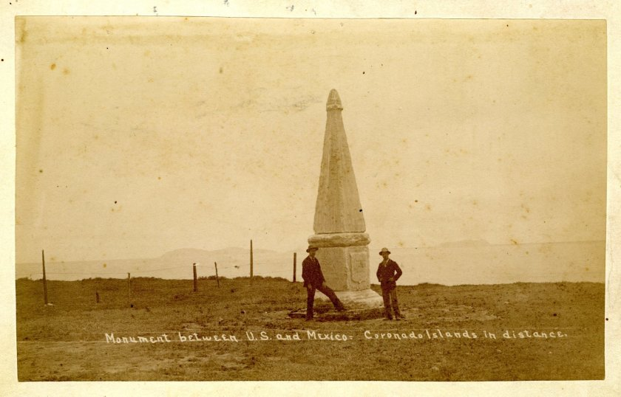
The San Diego-Tijuana Border 1851
Source: San Diego Union-Tribune archives

Slide 3
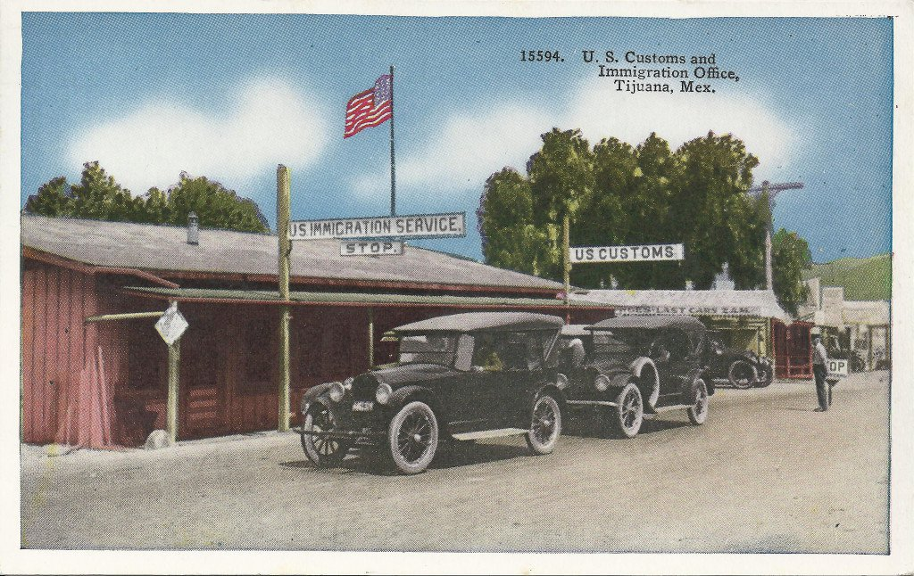
The San Diego-Tijuana Border circa 1910s
Source: coololdphotos.com

Slide 4
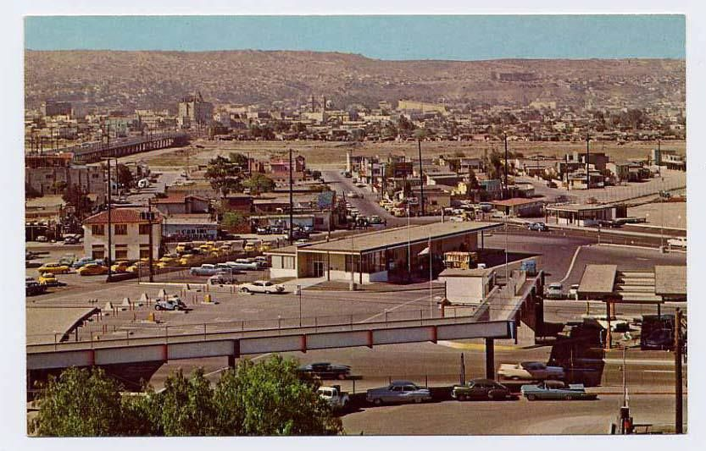
The San Diego-Tijuana Border circa 1960
Source: pinterest.com

Slide 5
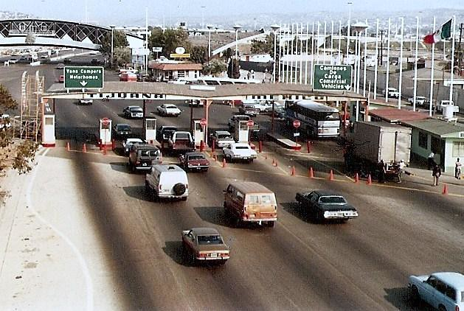
The San Diego-Tijuana Border 1981
Source: flickr.com

Slide 6
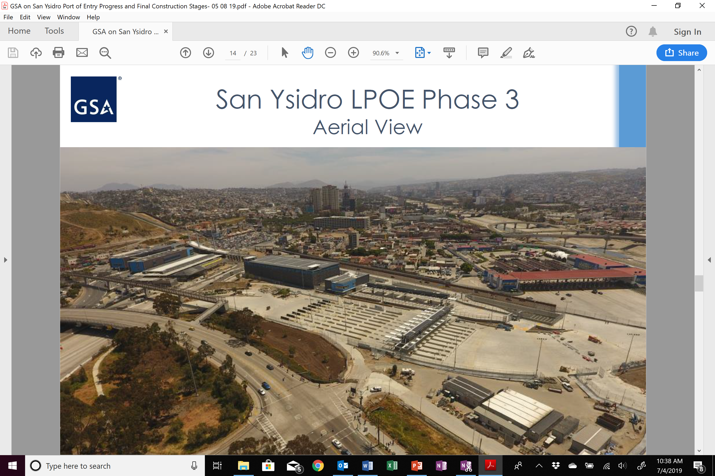
San Ysidro Port of Entry May 2019

Slide 7
Executive Director’s Report
Agenda
May Stakeholder Working Committee highlights
Border Innovation Challenge results
Insights
Initiative progress

Slide 8
Executive Director’s Report
May Stakeholder Working Committee meeting highlights
Ramón Riesgo, GSA: 4 new permanent southbound lanes to El Chaparral added on 5/14. It is estimated that 10 permanent lanes and inspection booths will be ready by 6/17/19 (see slides of his presentation).
Dennis Abremski and Lada Rasochova, UCSD on importance of Border Innovation Challenge
Stephen Roop, Freight Shuttle System: cargo conveyances on a dedicated and elevated guideway. It uses linear induction motors and the freeway right-of-way. In talks with Caltrans and Matrix Air Cargo to offer the solution in San Diego.
Antonio Ochoa, Deloitte Tijuana: Initial discussion on Cross Border Connected Cities (CBCC) concept, articulating a broader vision for border operations within an urban planning and Smart City context.

Slide 9
Topics
Border Innovation Challenge
33 applications, 8 semi-finalists, 5 finalists, 3 winners.
1st Prize, $10,000: "Dynamic Border Project" - Curbside Labs, Inc. and Cheslav Versky (UCSD)
2nd Prize, $7,500: "Cross Border Booking System" (CBBS), by Héctor Rodríguez Calderón and José Treviño Bustamante (Tijuana)
Audience Favorite, $2,500: “EMS Tracking”, by Mauricio de Oliveira, Carlos Vera, Eva Tovar and Andres Smith (UCSD)
Two other groups were finalists: "Automate the collection of border wait time data and process it for real time statistics", by Inercy and "Evolutionary Sensors: a machine learning SoC for IoT sensor systems", by Leonardo Trujillo, Yazmín Maldonado, and Carlos Goribar.
We will have these companies present at Stakeholders Working Committee meetings in September and November.

Slide 10
Dynamic Border
Project
BUILDING
DATA-DRIVEN
BORDER
TOMORROW
of
Curbside Labs, Inc
Notes:
Our goal is to utilize cutting-edge, patent-pending identity-independent computer vision technology to create a near-RealTime multi-factor border crossing measurement, reporting, and predictive analytics system to enable efficient policy making by all stakeholders and to serve as an independent information gateway to a wider audience.

Slide 11
CBBS
Cross Border Booking System
Making Freight Fast Again
José Treviño Calderón
Héctor Rodríguez Bustamante

Slide 12
EMSTrack
Improving emergency care and transport at the US-Mexico border
May 22, 2019

Slide 13
Executive Director’s Report
Insights
Border Data using WiFi readers
Collaboration with CDT and application to City of Tijuana funds for approval (Fondos Tijuana): $134,800 for 20 units and $2,550 for recurring fees
Pilot with 3 units for ~$5,000
Website Performance
July 2018: unique users were 678 and we had 732 sessions. In June 2019 we had 3,900 unique users and 5,500 sessions, 575% and 750% increases, respectively.
76% of use is mobile and 80% of traffic is from U.S. Top pages visited by far are “border wait times”, “crossing back into U.S.” and “crossing back into Mexico.” Top ad is “border wait times San Yisdro-Otay Mesa- Tecate”, and top keyword has been “san ysidro border time”.

Slide 14
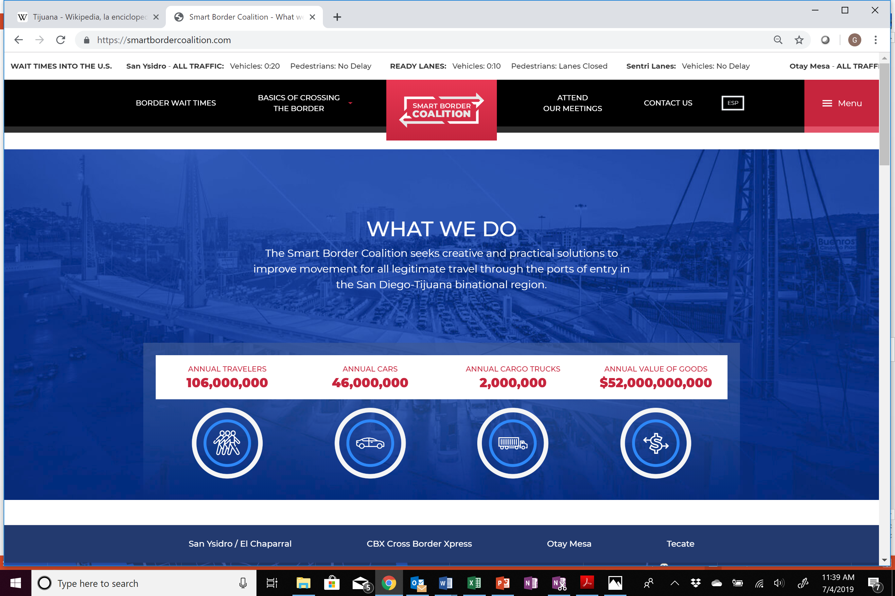

Slide 15
Executive Director’s Report
Insights
Border Trade Alliance and Wilson Center visit
Meetings on Capitol Hill – key topics were USMCA passage; immigration loopholes and CBP hiring need.
BTA meeting topics: USMCA, tariffs, threat of port closures, CBP officer reassignment, steel and aluminum tariffs and tomato suspension agreement.
Wilson Center: SBC was a panelist at the 6th annual Wilson Institute’s “Building a Competitive U.S.-Mexico Border” -- “21st Century Border Management at our Ports of Entry”. Needs: (1) building binational trust; (2) fine tuning frameworks to handle problem statements; (3) improving coordination between agencies; (4) improving data collection, interpretation and use; and (5) tapping alternative sources of funding for areas around the ports.

Slide 16
Executive Director’s Report
Initiative List and Progress
Wait Times: SBC is working with CDT in Tijuana to do a proof of concept. SBC and CDT have submitted a budget for 20 readers to Fondos Tijuana.
Signage: only 10 of the 16 nodes have been completed due to manufacturer delays and Fondos Tijuana fund postponement. Fondos Tijuana committee needs to authorize funds to supply tourism signage.
Access Roads: SBC is working with CDT on an initial design to make changes to the current medical lane, All Traffic access point, new Ready lanes and additional Ready Lane access point. This process requires additional internal validation before we present a formal proposal to the city.
Joint Inspection / Unified Cargo Processing: UCP is almost back to normal. The recently approved $4.6 billion appropriation for CBP will help bring all agents back and return to status before the agent assignment occurred.

Slide 17
Executive Director’s Report
Initiative List and Progress
Puerta de Mexico demolition
After former Aduanas General Administrator Ricardo Peralta was promoted to deputy Interior Minister, SAT has not called for additional bi-national meetings. There has been no word yet from the new SAT Administrator Ricardo Ahued.
Bid for executive project was being coordinated by SCT, using bidding system. Demolition was supposed to occur in June. This is a 60-day project and has an approximate cost of $1.7 million pesos, according to SCT’s delegate in Baja California, Felipe Verdugo. The second phase will include new pavement and a return lane. City of Tijuana has given go-ahead to use street. Investment between $10-$12 million pesos.
Export Corridor at Otay Mesa POE
Private property for the export corridor at Otay Mesa POE is available for donation to INDAABIN and subsequent assignment to SAT to manage. Land owner must provide documents to complete the donation, including power of attorney.

Slide 18
Executive Director’s Report
Initiative List and Progress
Tecate Railroad
CBP decided that inspection equipment must be on the U.S. side of the border and that MTS will be the agency in charge of leading this effort. There may be a need to reopen conversations with Mexican SRE and SAT to meet with U.S. authorities to reconsider.
SAT’s conclusion is that the most viable option will be for each country to have their own inspection facility. What is still subject to discussion is where non-intrusive inspection equipment (X-Rays, Gamma Rays) will be. SAT’s equipment Administrator will send proposal to CBP.
Otay II
Time frame for land acquisition and traffic study

Slide 19
Executive Director’s Report
Social Media
@smartbordercali
Smartbordercoalition
smartbordercali

Slide 20
Next meeting is at the San Diego Foundation on Thursday September 5, 2019
THANK YOU

